Slide 1
Introduction to Machine Learning
Cynthia Rudin | MIT Sloan School of Management

Slide 2
Introduction to Machine Learning
Classification
Regression
Statistical Learning Theory for Supervised Learning
Clustering
Recommender Systems

Slide 3
Classification
Cynthia Rudin | MIT Sloan School of Management

Slide 4
Machine Learning
Grew out of artificial intelligence within computer science. Teaches computers by example.
ML is arguably part of statistics.
Is this a chair?
Notes:
Machine learning as a field, *read*
If we want to teach the computer to recognize images of chairs, then we give the computer a whole bunch of images, and tell it which ones are chairs and which are now, and then it’s supposed to learn to recognize chairs, even ones it hasn’t seen before. It’s not like we tell the computer how to recognize a chair, we don’t tell it “a chair has 4 legs and a back and a flat surface to sit on and so on”, we just give it a lot of examples.
Machine learning has close ties to statistics, in fact it’s hard to say what’s different about predictive statistics and machine learning, and these fields are very closely linked right now.

Slide 5

Classification
We have a training set of observations (e.g., labeled images) and a test set that we use only for evaluation.
Training set
Test set
(not a chair)
(chair)
(not a chair)
(chair)
(not a chair)
(not a chair)
(not a chair)
(not a chair)
Notes:
The problem I just told you about is a classification problem where we are trying to identify chairs. The way we set the problem up is that we have a *read*
We use the training set to learn a model of what a chair is. The test set are images that are not in the training set, and we want to be able to make predictions on those, as to whether or not each image is a chair.
It could be that some the labels on the training set are noisy. That could happen. In fact one if these labels is noisy *point*. That’s ok, because as long as their isn’t too much noise, we should still be able to learn a model for a chair. It just won’t be able to classify perfectly, and that happens. Some prediction problems are harder than others, but that’s ok, we just do the best we can from the training data. And in terms of the size of the training data, the more the merrier. We want as much data as we can to train these models.

Slide 6


Classification
Each observation is represented by a set of numbers (features).
Each pixel gets rgb values like [1.0,0.9,0.8]
Image becomes:
[1.0,0.9,0.8,0.1,0.5,…]
(Label is -1, it’s not a chair)
Notes:
How do we represent an image of a chair, or a flower, or whatever, in the training set? I just zoomed in on a piece of this image over here, and you can see that the pixels in the image. We can represent each pixel according to its rgb values (red green blue), so we get three numbers representing each image. So you can represent the whole image as a collection of rgb values. So the image becomes this very large vector of numbers. And in general, when doing machine learning, we need to represent each observation in the training and test sets as a vector of numbers. The label is also represented by a number. Here the number is -1 because the image is not a chair. The chairs would all get label +1.

Slide 7
Classification
Each observation is represented by a set of numbers (features).
Manhole is represented as: [ 5 3 120 12 1 0 ….. ]
Inspected?
Vented cover?
Number of events last year
Number of electrical cables
Number of serious events last year
Number of pre-1930 electrical cables
Notes:
Here’s another example. This is a problem that comes from NYC’s power company, where they wanted to predict which manholes were going to have a fire. So we would represent each manhole as a vector, and here are the components in the vector. The first component might be *read*.
In general, the first step is to figure out how to represent your data as a vector. You can make the vector very large, you can include lots of factors if you like, that’s fine. Computationally things are easier if you use fewer features, but then you risk leaving out information. So there’s a tradeoff right there that you will have to worry about, and we’ll talk more about that later. But in any case, you can’t do ML if you don’t have your data represented this way, so that’s the first step. *pause*
You’d think that manholes with more cables, more recent serious events, etc. would be more prone to explosions and fires in the future. But what combination of them would give you the best predictor? How do you combine them together? You could add them all up but that might not be the best thing. You could give them all weights and add them up, but how do you know the weights? That’s what ML does for you. It tells you what combinations to use to get the best predictors.

Slide 8
Classification
Each observation is represented by a set of numbers (features).
Manhole is represented as: [ 5 3 120 12 1 0 ….. ]
Inspected?
Vented cover?
Number of events last year
Number of electrical cables
Number of serious events last year
Number of pre-1930 electrical cables
Training feature data is from 2014 and before
(Label is 1, it exploded in 2013)
Notes:
For the manhole problem, we want to use the data from the past to predict the future. So, for instance, the feature data might be from 2014 and before.

Slide 9
Classification
Each observation is represented by a set of numbers (features).
Manhole is represented as: [ 5 3 120 12 1 0 ….. ]
Inspected?
Vented cover?
Number of events last year
Number of electrical cables
Number of serious events last year
Number of pre-1930 electrical cables
Training feature data is from 2014 and before
Label is 1 if it had an event in 2015
Notes:
*read* so that’s our training set.

Slide 10
Classification
Each observation is represented by a set of numbers (features).
Manhole is represented as: [ 5 3 120 12 1 0 ….. ]
Inspected?
Vented cover?
Number of events last year
Number of electrical cables
Number of serious events last year
Number of pre-1930 electrical cables
Testing feature data is from 2015 and before
Predict what happen in 2016
Notes:
*Read* we predict the labels for 2016.

Slide 11
Classification
Each observation is represented by a set of numbers (features).
Manhole is represented as: [ 5 3 120 12 1 0 ….. ] -1
[ 0 0 89 5 1 1 ….. ] 1
[ 1 0 20 0 0 1 ….. ] -1
: :
Features, called X
Labels, called Y
(Predictors, Covariates, Explanatory Variables, Independent Variables)
Notes:
Just to be formal about it, *Read*
The features are also called *read* so you can choose whatever terminology you like.

Slide 12
Classification
Formally, given training set (x_{i,}y_{i}) for i=1…n, we want to create a classification model f that can predict label y for a new x.
Notes:
Even more formally, we are given a training set of feature label pairs xi yi, and there are n of them, and

Slide 13
Classification
Formally, given training set (x_{i,}y_{i}) for i=1…n, we want to create a classification model f that can predict label y for a new x.
Manhole is represented as: [ 1925 15]
Year oldest cable installed
Number of events last year
Notes:
Let’s take a simple version of the manhole example where we have only two features, *Read*. So each observation can be represented as a point on a 2d graph, which means I can plot the whole dataset.

Slide 14
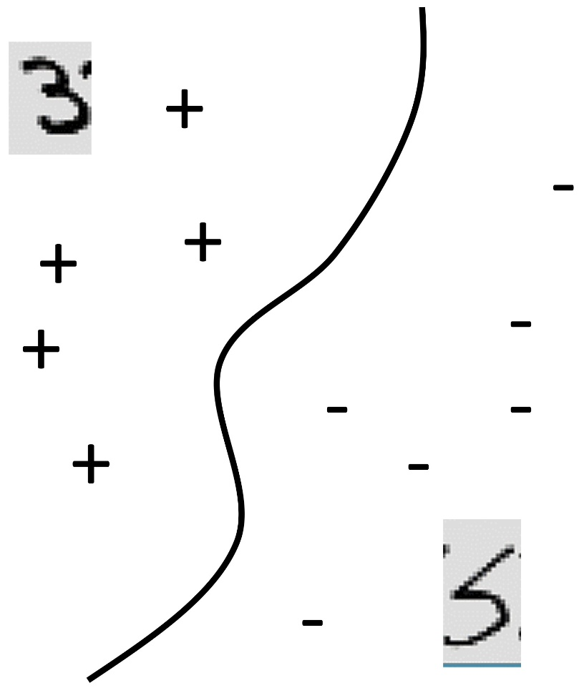
Classification
Formally, given training set (x_{i,}y_{i}) for i=1…n, we want to create a classification model f that can predict label y for a new x.
20
Manhole is represented as: [ 1925 15]
Events Last Year
Year oldest cable installed
Number of events last year
0
1925
Oldest cable
2015

Slide 15
Classification
Formally, given training set (x_{i,}y_{i}) for i=1…n, we want to create a classification model f that can predict label y for a new x.
20
f(x)>0
f(x)=0
f(x)<0
Manhole is represented as: [ 1925 15]
Events Last Year
Year oldest cable installed
Number of events last year
0
1925
Oldest cable
2015

Slide 16
Classification
Formally, given training set (x_{i,}y_{i}) for i=1…n, we want to create a classification model f that can predict label y for a new x.
20
f(x)>0
f(x)=0
f(x)<0
f(x) = function(Events Last Year, Oldest Cable)
Events Last Year
0
1925
Oldest cable
2015

Slide 17
Classification
Formally, given training set (x_{i,}y_{i}) for i=1…n, we want to create a classification model f that can predict label y for a new x.

Slide 18
Classification
Formally, given training set (x_{i,}y_{i}) for i=1…n, we want to create a classification model f that can predict label y for a new x.
The machine learning algorithm will create the function f for you. It might be very complicated, but the way to use is is not complicated:
The predicted value of y for a new x is the sign of f(x).

Slide 19
Classification
Yes/No questions is the most basic
automatic handwriting recognition, speech recognition, biometrics, document classification, spam detection, predicting credit default risk, detecting credit card fraud, predicting customer churn, predicting medical outcomes (strokes, side effects, etc.)

Slide 20
Regression
Cynthia Rudin | MIT Sloan School of Management
Notes:
regression

Slide 21
Regression
For predicting real-valued outcomes:
How many customers will arrive at our website next week?
How many tv’s will we sell next year?
Can we predict someone’s income from their click through information?
Notes:
Supervised regression = regression

Slide 22
Regression
Each observation is represented by a set of numbers.
Income
A person is represented as: [ 5 3 120 12 1 0 ….. ] 84
[ 0 0 89 5 1 1 ….. ] 32
[ 1 0 20 0 0 1 ….. ] -10
: :
Features, called X
Labels, called Y

Slide 23
Regression
Each observation is represented by a set of numbers.
Income
A person is represented as: [ 5 ] 84
[ 0 ] 32
[ 1 ] -10
:
Single feature, called X
Labels, called Y

Slide 24
Regression
Formally, given training set (x_{i,}y_{i}) for i=1…n, we want to create a regression model f that can predict label y for a new x.
1,000K
f(x) = function(Number of Businessweek clicks)
f(x)
Income
0
2000
0
Number of Businessweek clicks

Slide 25
Regression
Formally, given training set (x_{i,}y_{i}) for i=1…n, we want to create a regression model f that can predict label y for a new x.
1,000K
f(x) = function(Number of Businessweek clicks)
f(x)
Income
(Overfitting?)
0
2000
0
Number of Businessweek clicks

Slide 26
Regression
Formally, given training set (x_{i,}y_{i}) for i=1…n, we want to create a regression model f that can predict label y for a new x.
1,000K
f(x) = function(Number of Businessweek clicks)
= 5K*Number of Businessweek clicks + 100K
f(x)
Income
(Underfitting?)
0
2000
0
Number of Businessweek clicks

Slide 27
Regression
Formally, given training set (x_{i,}y_{i}) for i=1…n, we want to create a regression model f that can predict label y for a new x.
1,000K
f(x) = function(Number of Businessweek clicks)
f(x)
Income
(Just right?)
We’ll talk more about this later
0
2000
0
Number of Businessweek clicks

Slide 28
Regression
Formally, given training set (x_{i,}y_{i}) for i=1…n, we want to create a regression model f that can predict label y for a new x.
Estimated income:
f(x) = function(Number of visits to upscale furniture websites, Number of Businessweek clicks, Number of distinct people emailed per day, Number of purchases of over 5K within the last month, Number of visits to airlines, etc.)
For instance,
f(x) = 3*Number of visits to upscale furniture websites
+10*Number of Businessweek clicks
+100*Number of distinct people emailed per day
+2*Number of purchases of over 5K within the last month
+10*Number of visits to airlines
But f(x) could be much more complicated

Slide 29
Supervised Learning
Classification and Regression are supervised learning problems.
“Supervised” means that the training data has ground truth labels to learn from.
(Supervised) classification often has +1 or -1 labels.
(Supervised) regression has numerical labels.
There are lots of other supervised problems.
Supervised learning algorithms are much easier to evaluate than unsupervised ones.

Slide 30
Statistical Learning Theory for Supervised Learning
Cynthia Rudin | MIT Sloan School of Management
Notes:
Statistical learning theory

Slide 31
Statistical Learning Theory
Occam’s Razor: The best models are simple models that fit the data well.
William of Ockham, English frier and philosopher (1287-1347) said that among hypotheses that predict equally well, we should choose the one with the fewest assumptions.

Slide 32
Statistical Learning Theory
Occam’s Razor: The best models are simple models that fit the data well.
1,000K
f(x)
Income
0
2000
0
Number of Businessweek clicks

Slide 33
Statistical Learning Theory
Occam’s Razor: The best models are simple models that fit the data well.
1,000K
f(x)
Income
0
2000
0
Number of Businessweek clicks

Slide 34
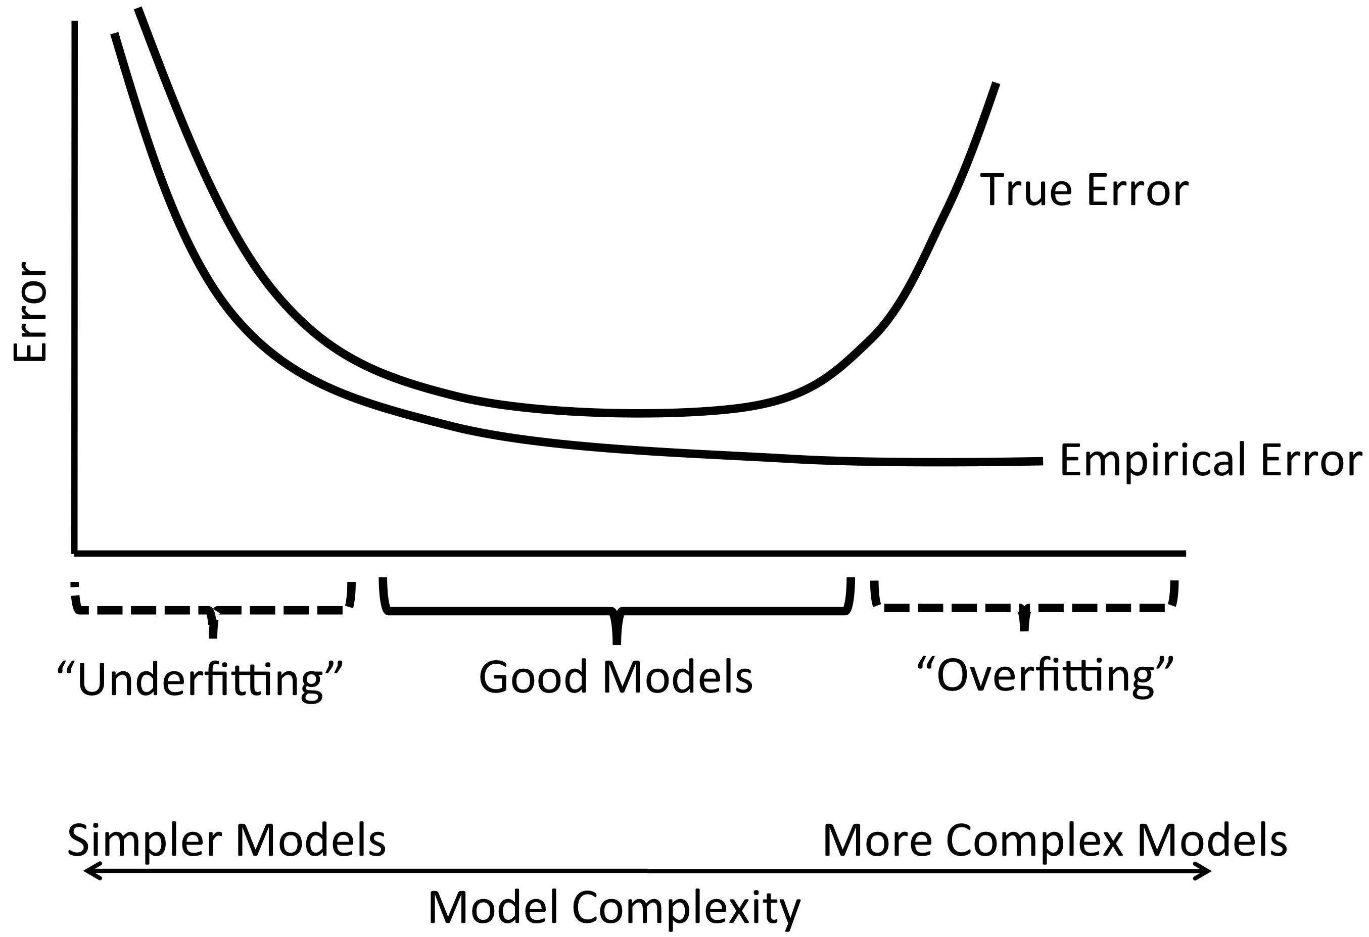
Statistical Learning Theory
Occam’s Razor: The best models are simple models that fit the data well.
Test Error
Training Error

Slide 35
Statistical Learning Theory
Occam’s Razor: The best models are simple models that fit the data well.
Test Error
Training Error
Notes:
True for classification, regression, etc.

Slide 36
Statistical Learning Theory
Occam’s Razor: The best models are simple models that fit the data well.
We need a balance between accuracy and simplicity.

Slide 37
Statistical Learning Theory
Occam’s Razor: The best models are simple models that fit the data well.
We need a balance between accuracy and simplicity.
Most common machine learning methods choose f to minimize training error and complexity.
Aims to thwart the “curse” of dimensionality.
Notes:
Occham prolly ddn’t know optimization but this would have suited him just fine I’m guessing if he were alive now.
Curse of dimensionality is that we tend to overfit when we have a lot of features and not as much data. Data needs to increase exponentially with the number of features in order not to have it.

Slide 38
Clustering
Cynthia Rudin | MIT Sloan School of Management
Notes:
unsupervised

Slide 39
Unsupervised Learning
“Unsupervised” means that the training data has no ground truth labels to learn from.
Supervised:
(chair)
(not a chair)
(not a chair)
chair?
(chair)
(not a chair)
(chair)
(not a chair)

Slide 40
Unsupervised Learning
“Unsupervised” means that the training data has no ground truth labels to learn from.
Unsupervised:

Slide 41
Unsupervised Learning
“Unsupervised” means that the training data has no ground truth labels to learn from.
Unsupervised:

Slide 42
Unsupervised Learning
“Unsupervised” means that the training data has no ground truth labels to learn from.
This means they are much harder to evaluate.
Clustering is an key unsupervised problem.

Slide 43
Recommender Systems and Matrix Factorization
Cynthia Rudin | MIT Sloan School of Management
Notes:
Recommender systems

Slide 44
Recommender Systems and Matrix Factorization
The Netflix contest: Build a better recommender system from Netflix data
A B C D
Carmen
Joseph
Leonore
Esmerelda
Use the crowd’s votes to complete the missing entries
Notes:
Let’s say you want to figure out what Joseph’s rating for movie C would be. How do you do it? Maybe use Carmen. Maybe C’s ratings were bad overall (not true here), so we think Joseph won’t like it.
This problem is supervised by the way. You can leave part of your data out and evaluate the quality of your algorithm on it.

Slide 45
Coming up
Cynthia Rudin | MIT Sloan School of Management
Notes:
Recommender systems

Slide 46
Coming Up
How to formulate and solve machine learning problems
How to evaluate machine learning algorithms

